Slide 1
River Processes and Landforms
By:
Ms. Annu
Assistant Professor, Department of Geography,
KM Kharkhoda, Sonipat

Slide 2
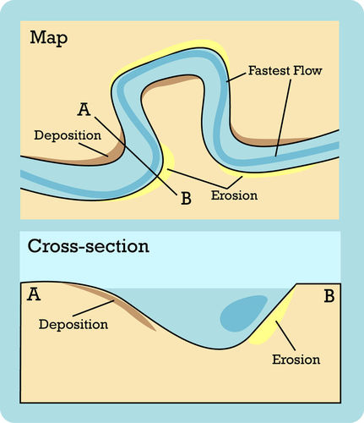
River Processes
Erosion removes material from a river bed making it deeper/wider
These pebbles, sand, silt, etc. get transported downstream (river's load)
Deposition occurs after a river no longer has enough energy to carry the load and drops it on the river bed-boulders first, silt & mud last

Slide 3
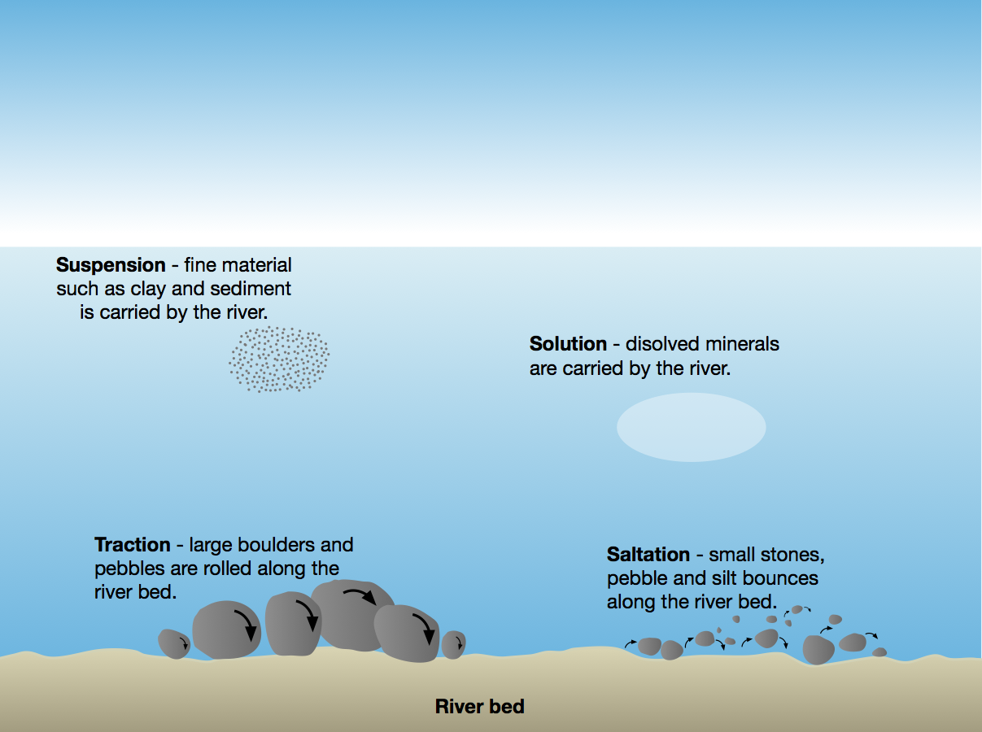
How a River Transports?

Slide 4
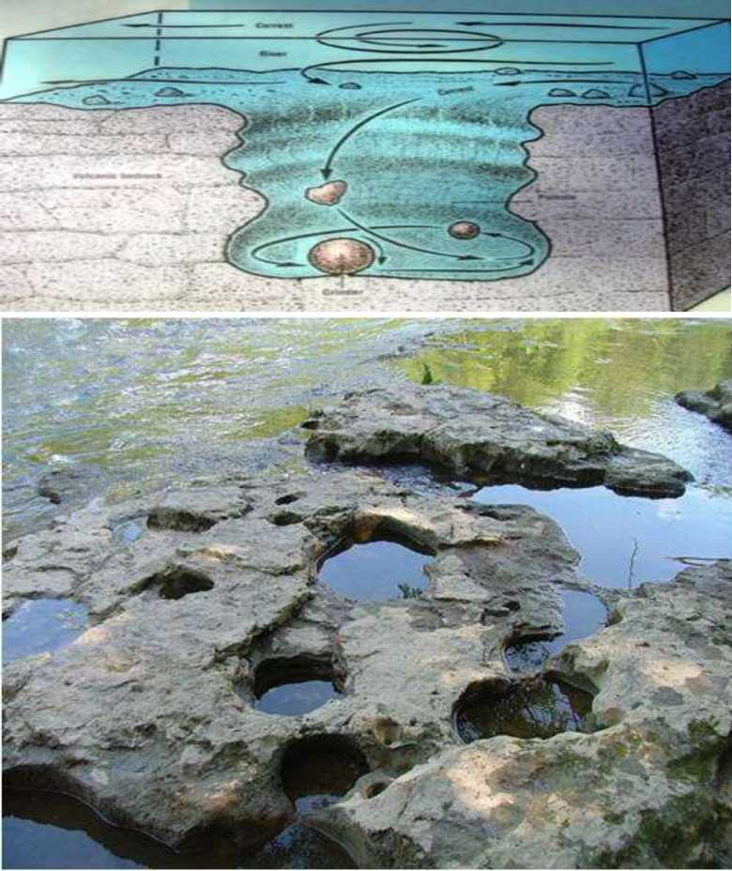
Upper Course
Where the river starts in a highland or mountainous area vertical erosion can be great in some areas and create gorges, canyons, potholes
Potholes
  Smooth rounded hollows formed by stones trapped in the hollows of a river bed.

Slide 5
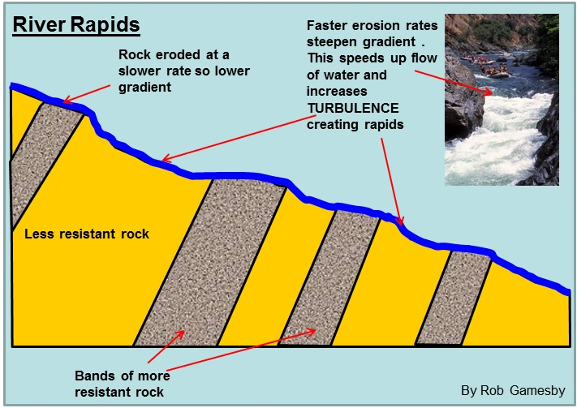
Upper Course
Rapids
  Form where the water is shallow and the river bed is rocky & irregular making the water rough
  Usually in steeper areas
  Can make river travel difficult unless doing white water rafting or kayaking

Slide 6
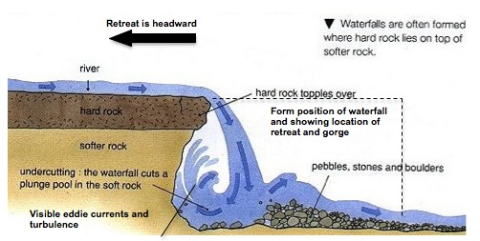
Upper Course
Waterfalls & Gorges

Slide 7
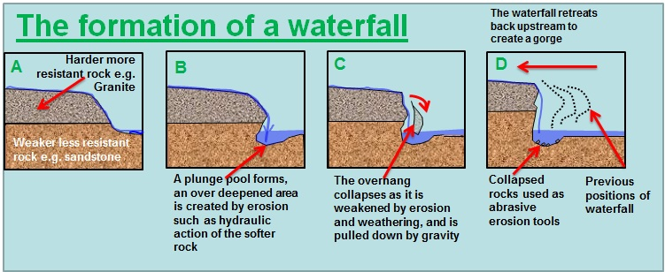
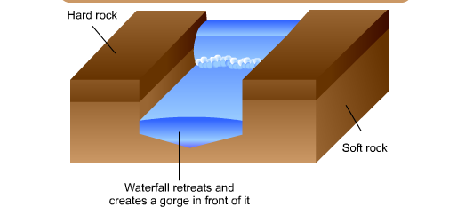
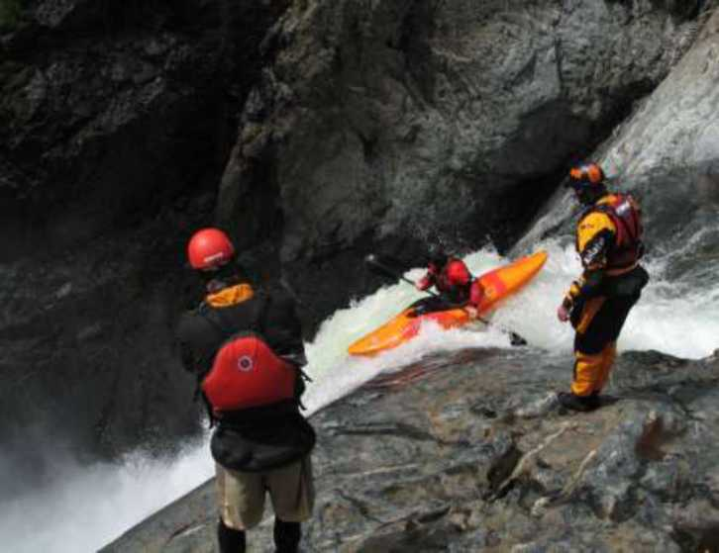

Slide 8
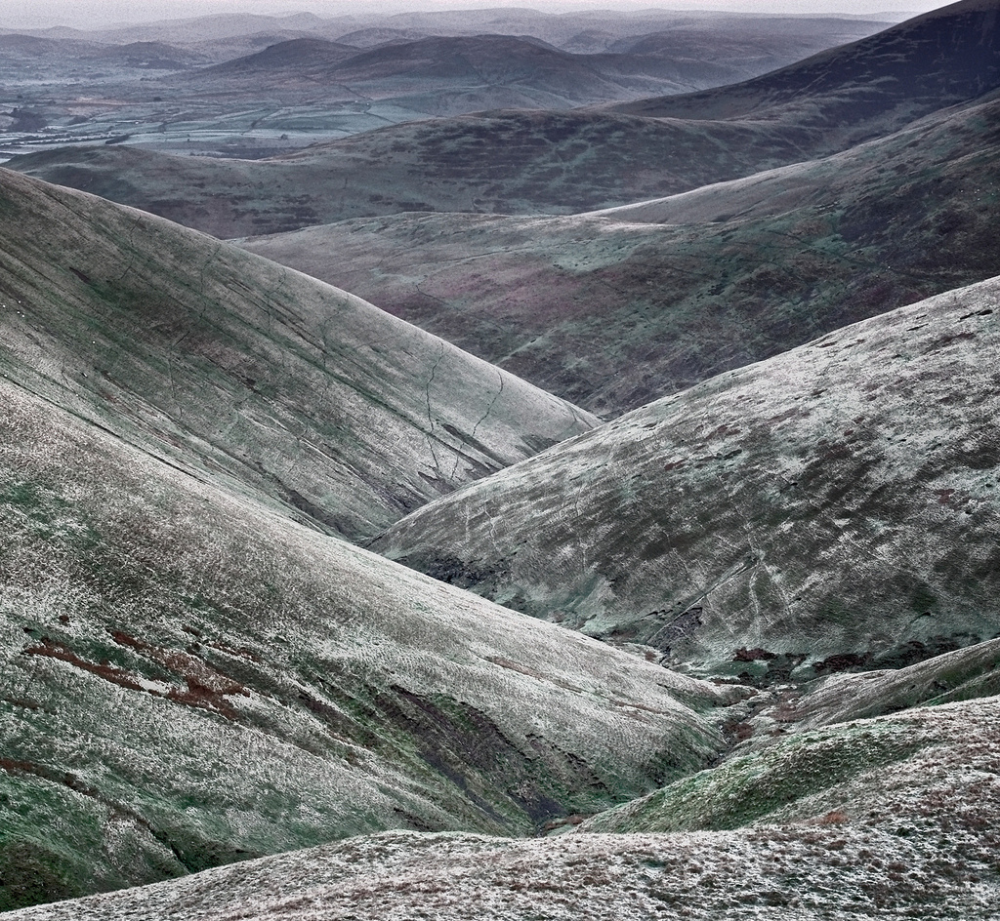
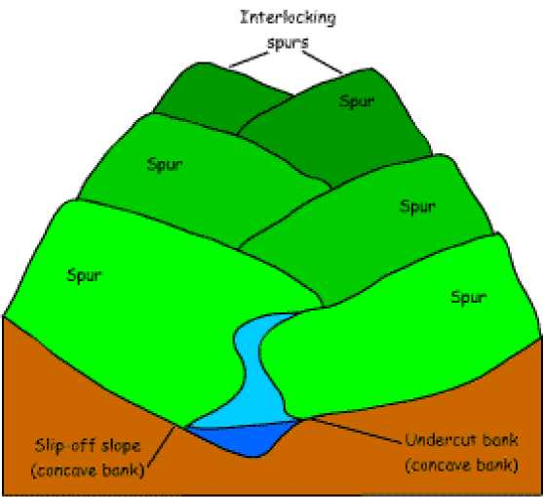
Upper Course
Interlocking Spurs
  Narrow valleys force the river to create a winding path.

Slide 9
Middle and Lower Course
As the river valley begins to widen and become less steep, riven begin to see more lateral (sideways) erosion.
Vertical erosion may stop completely by the time we reach the lower course.

Slide 10
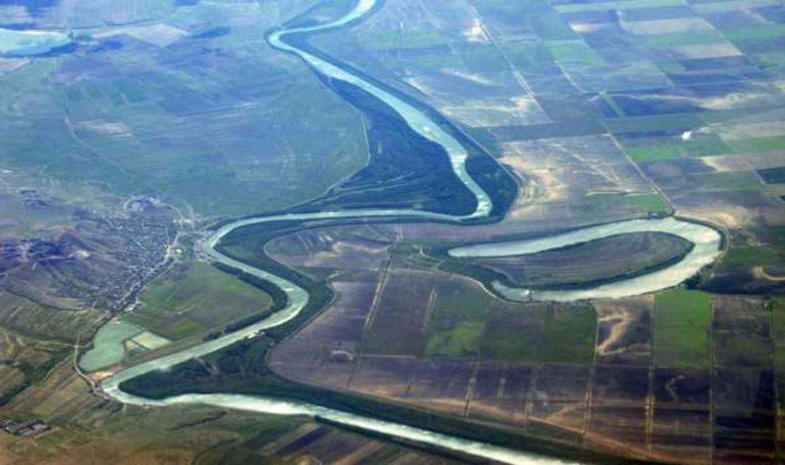
Middle and Lower Course
Meanders and Ox-bows
A meander is a winding curve or bend in a river. Meanders are the result of both erosional and depositional processes.
An oxbow lake is a U-shaped lake that forms when a wide meander of a river is cut off, creating a free-standing body of water.

Slide 11
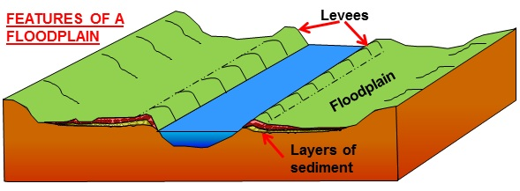
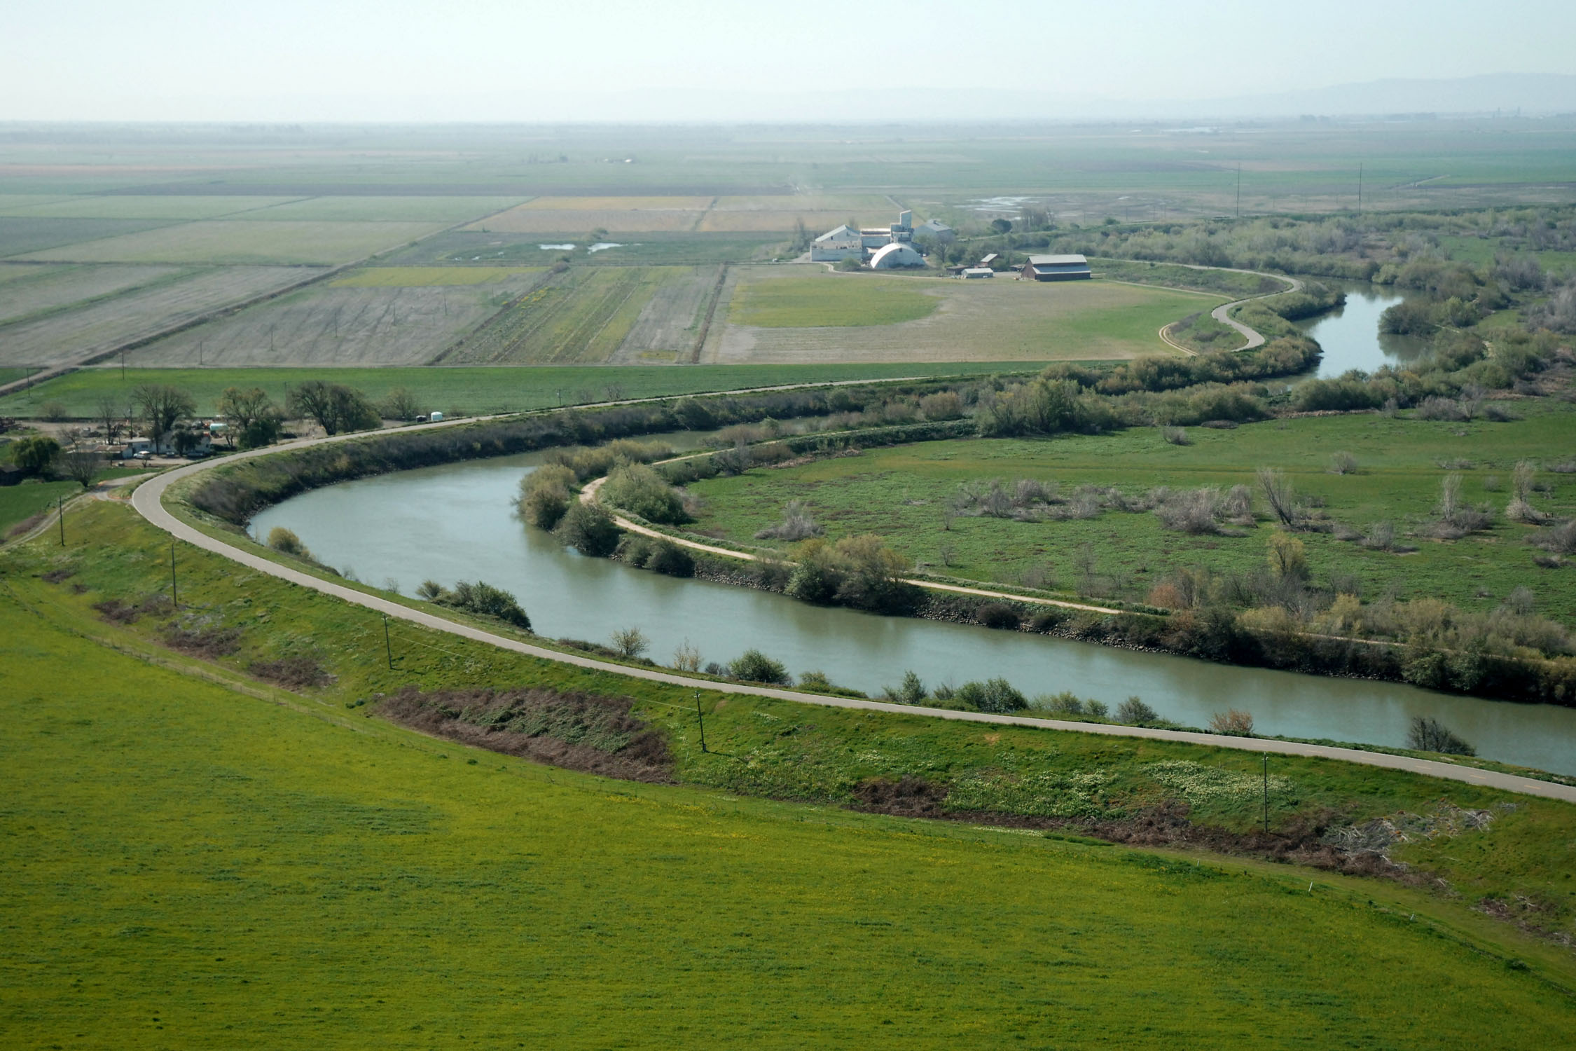
Middle and Lower Course
Floodplains and Levees
Flat land next to a river liable to flood
Occasionally the river flows above the level of the surrounding plain but is enclosed by raised embankments called levees

Slide 12
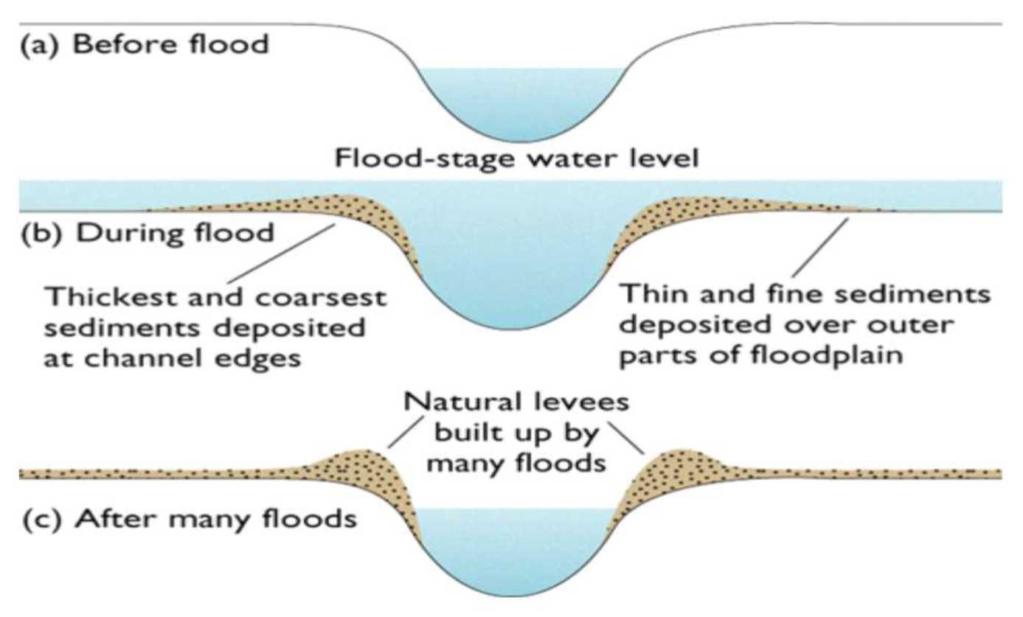

Slide 13
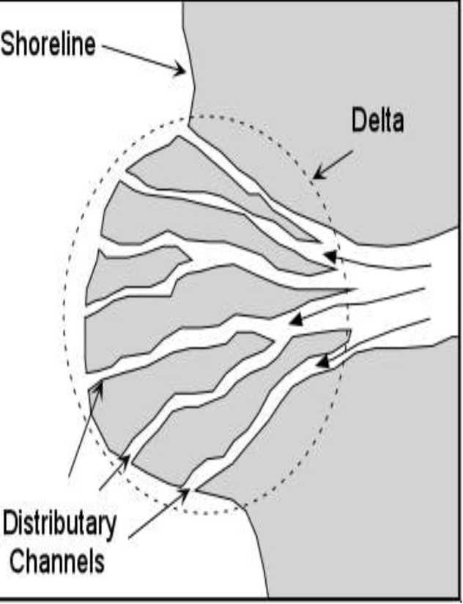
Middle and Lower Course
Deltas
Low-lying flat marshy land where a river meets a sea/lake
Formed from a river with carrying a lot of sediments that meets still sea/lake and the sediments build up
May cause distributaries

Slide 14
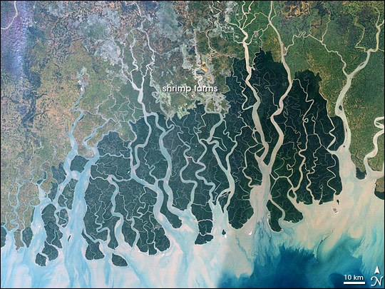

Slide 15
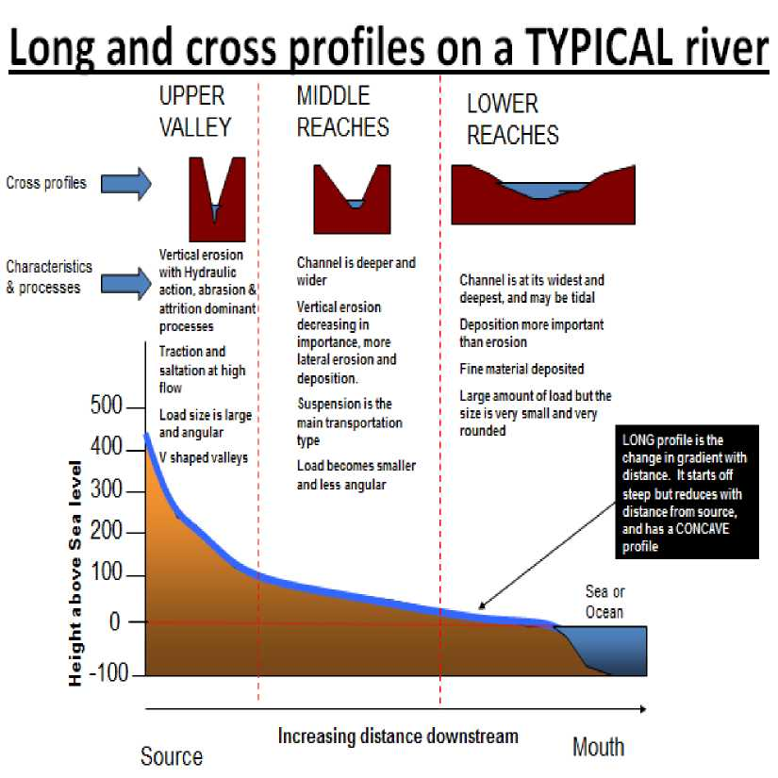
The Long Profile of a River
A line drawn from the source of the river to the mouth showing how the gradient changes.
Typically steep in the upper course and more gentle and smooth in the lower course
Erosion & deposition remove irregularities in the profile making it smooth and concave.

